Slide 1
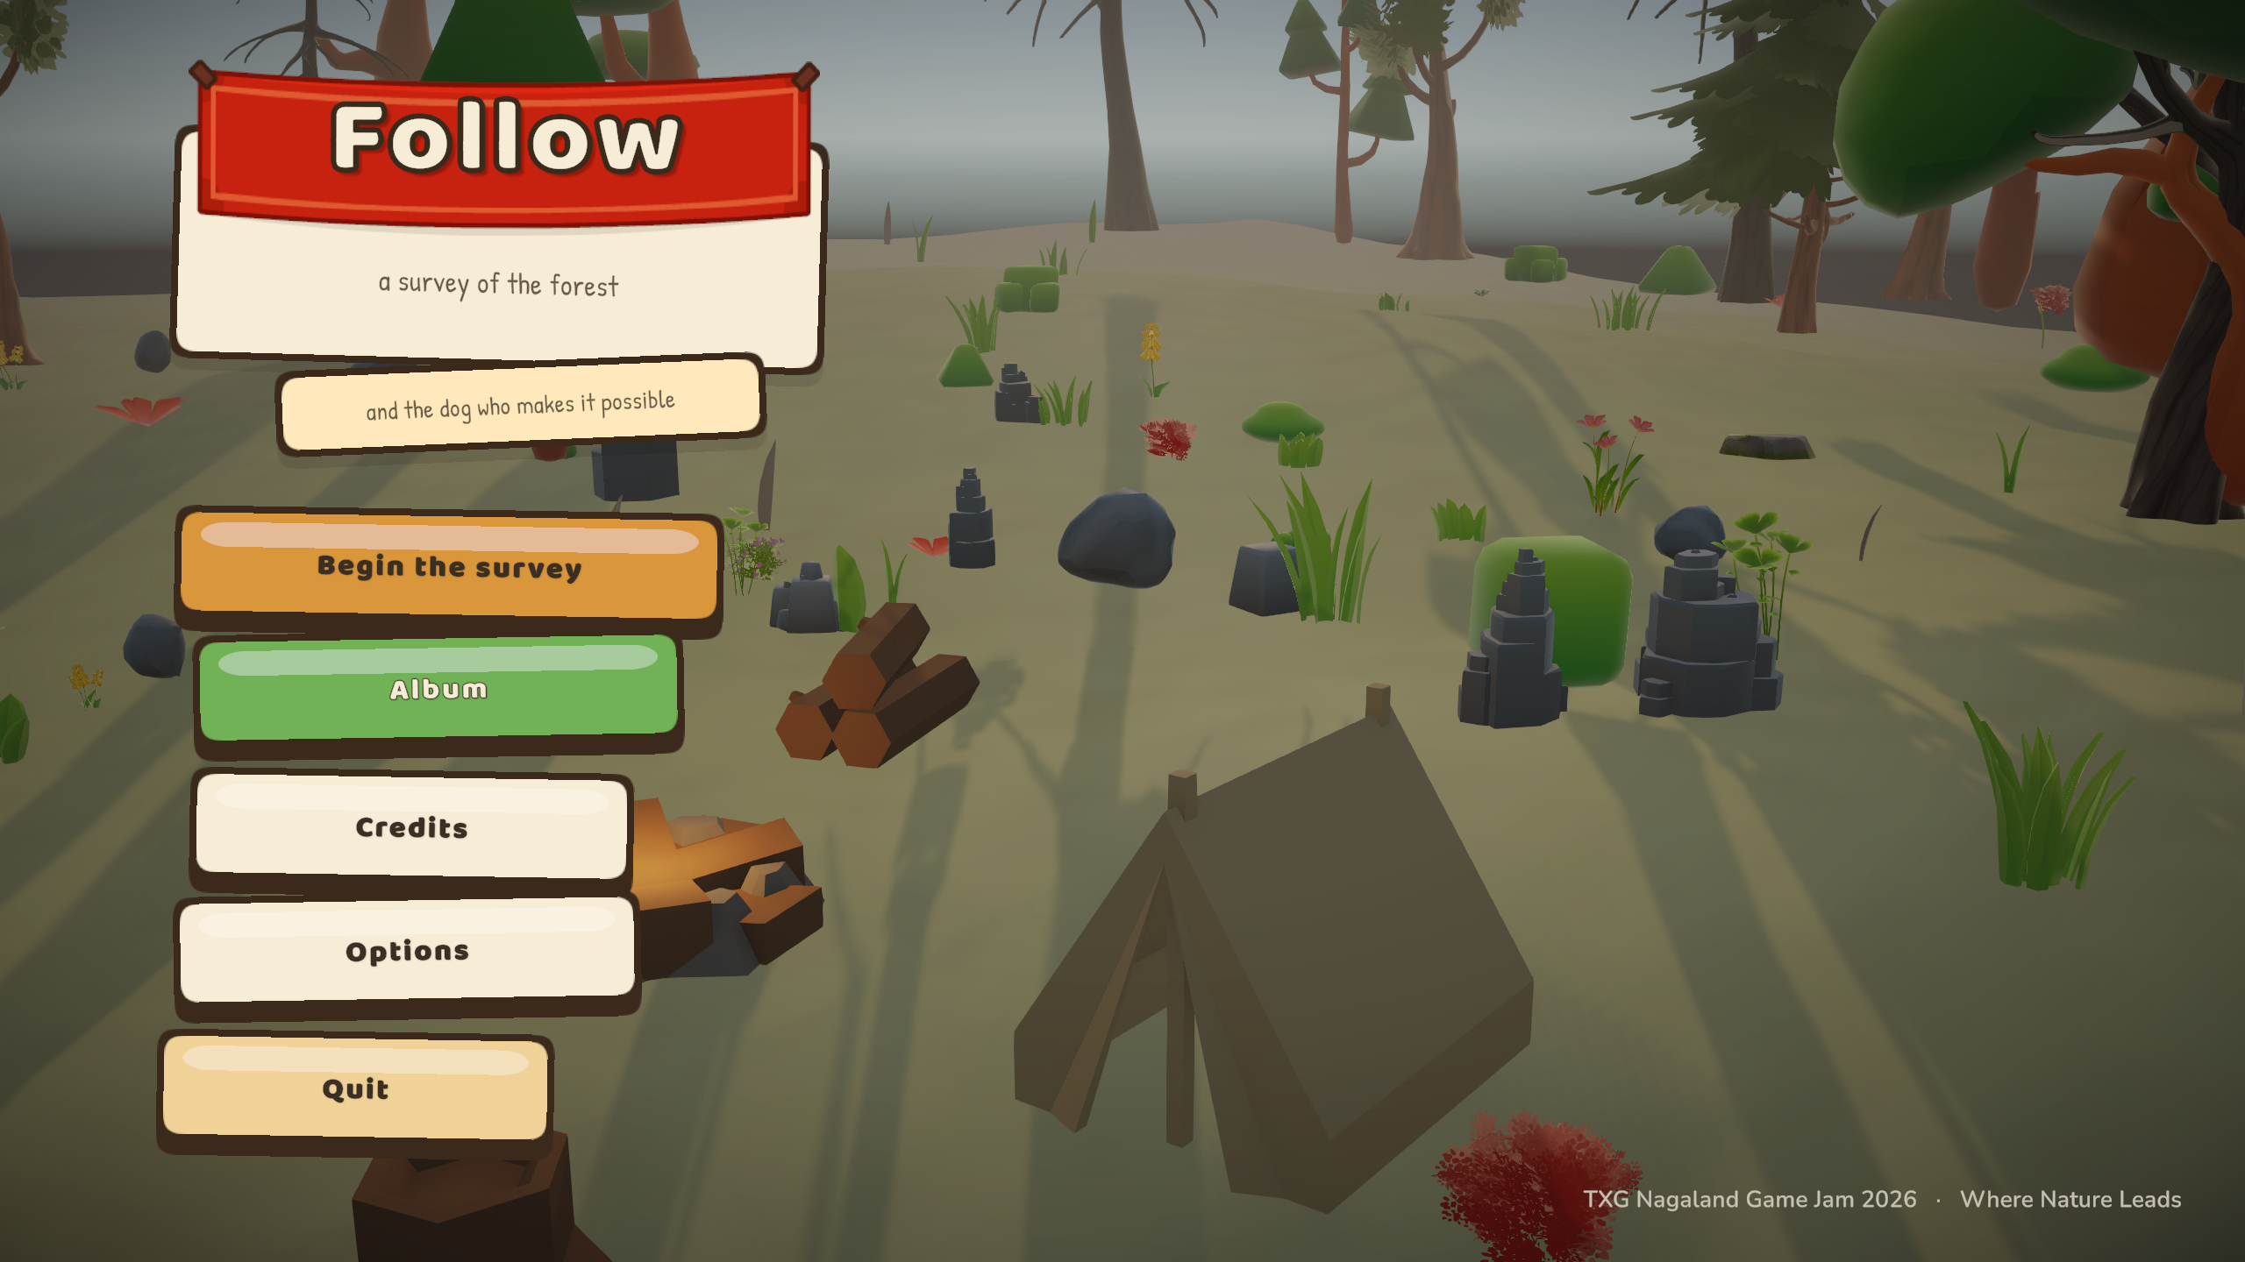
Follow
A survey of the forest, and the dog who makes it possible.
TXG Nagaland Game Jam 2026 · Where Nature Leads

Slide 2
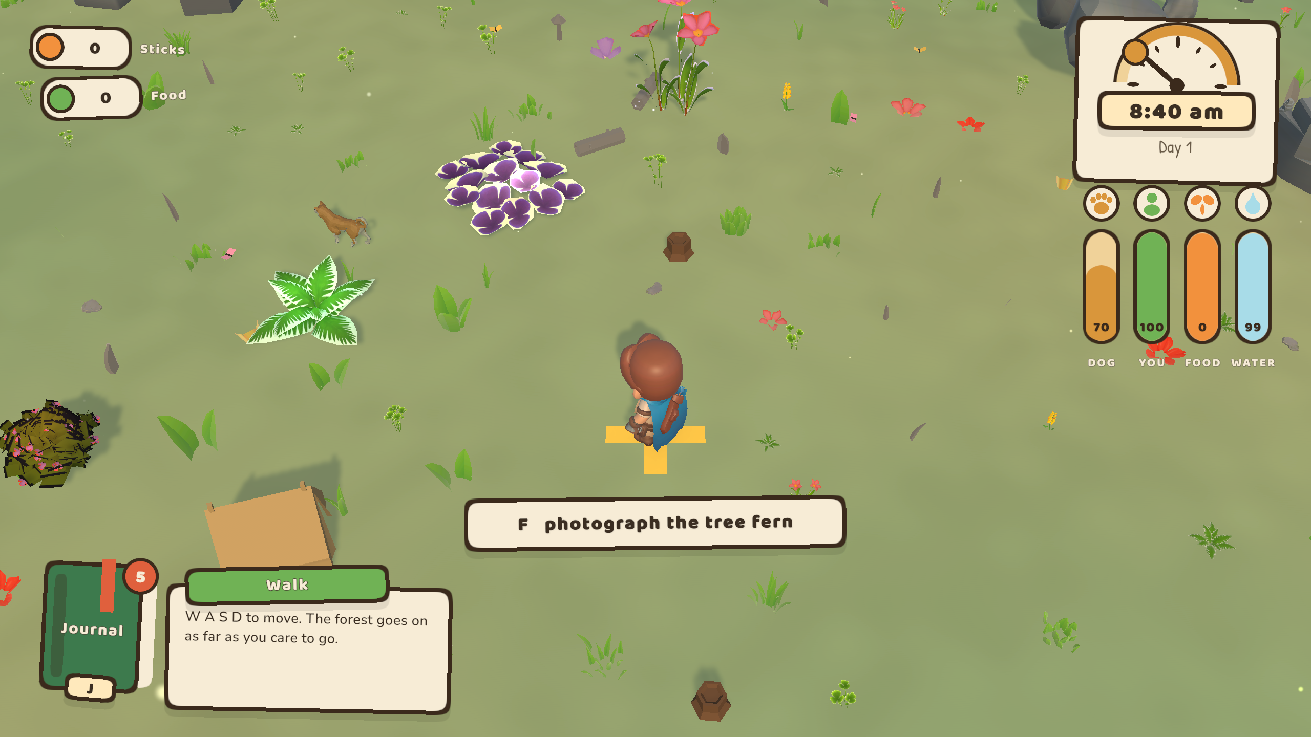
Where Nature Leads
We took the theme literally.
You cannot find most of this forest on your own. The animals are behind thickets, or they heard you coming. What you have is a young Shiba Inu who works ahead of you, picks up a scent, stops over it and barks until you arrive.
She is not a tool and she is not commanded. Every behaviour she has is chosen by her, weighted by how much she currently trusts you. Nature leads; you follow, with a camera.
The dog decides. You keep up.
Follow · 2/10

Slide 3
The loop
1 She finds
The dog ranges out to 58 m, catches a scent and points. The bark is the only thing telling you where to look.
2 You photograph
Press F, then answer a row of arrows before the bar runs out. Clean run, clean plate.
3 It goes in the book
Graded and filed. Only your best shot per species is kept, so re-photographing is always worth doing.
4 The day runs out
Firewood, water, food. When the light goes the survey stops and you head for the fire.
There is no ending. There is a journal that fills up.
Follow · 3/10

Slide 4
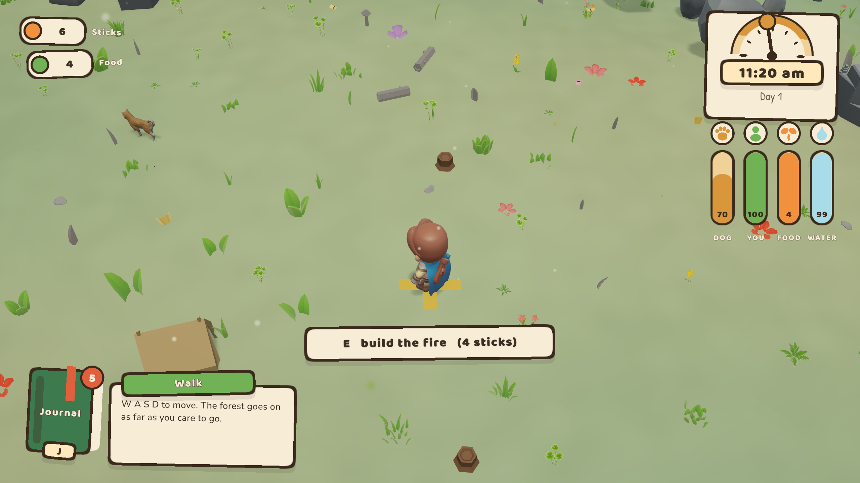
The dog
A state machine of nine behaviours - range, scent, point, fetch, deliver, lead, rest - with every transition weighted by bond.
She works a 58 m radius, gives up on trails she cannot reach, and rests between finds so she is not permanently shouting at you. Whistle with Q and she comes and stays for a window that grows as she trusts you - unless she is stood over something, in which case she holds it and barks back.
Bond is never a number on screen. You read it off where she chooses to lie down when you sleep.
Q whistle
G share food
she leads you home
Follow · 4/10

Slide 5
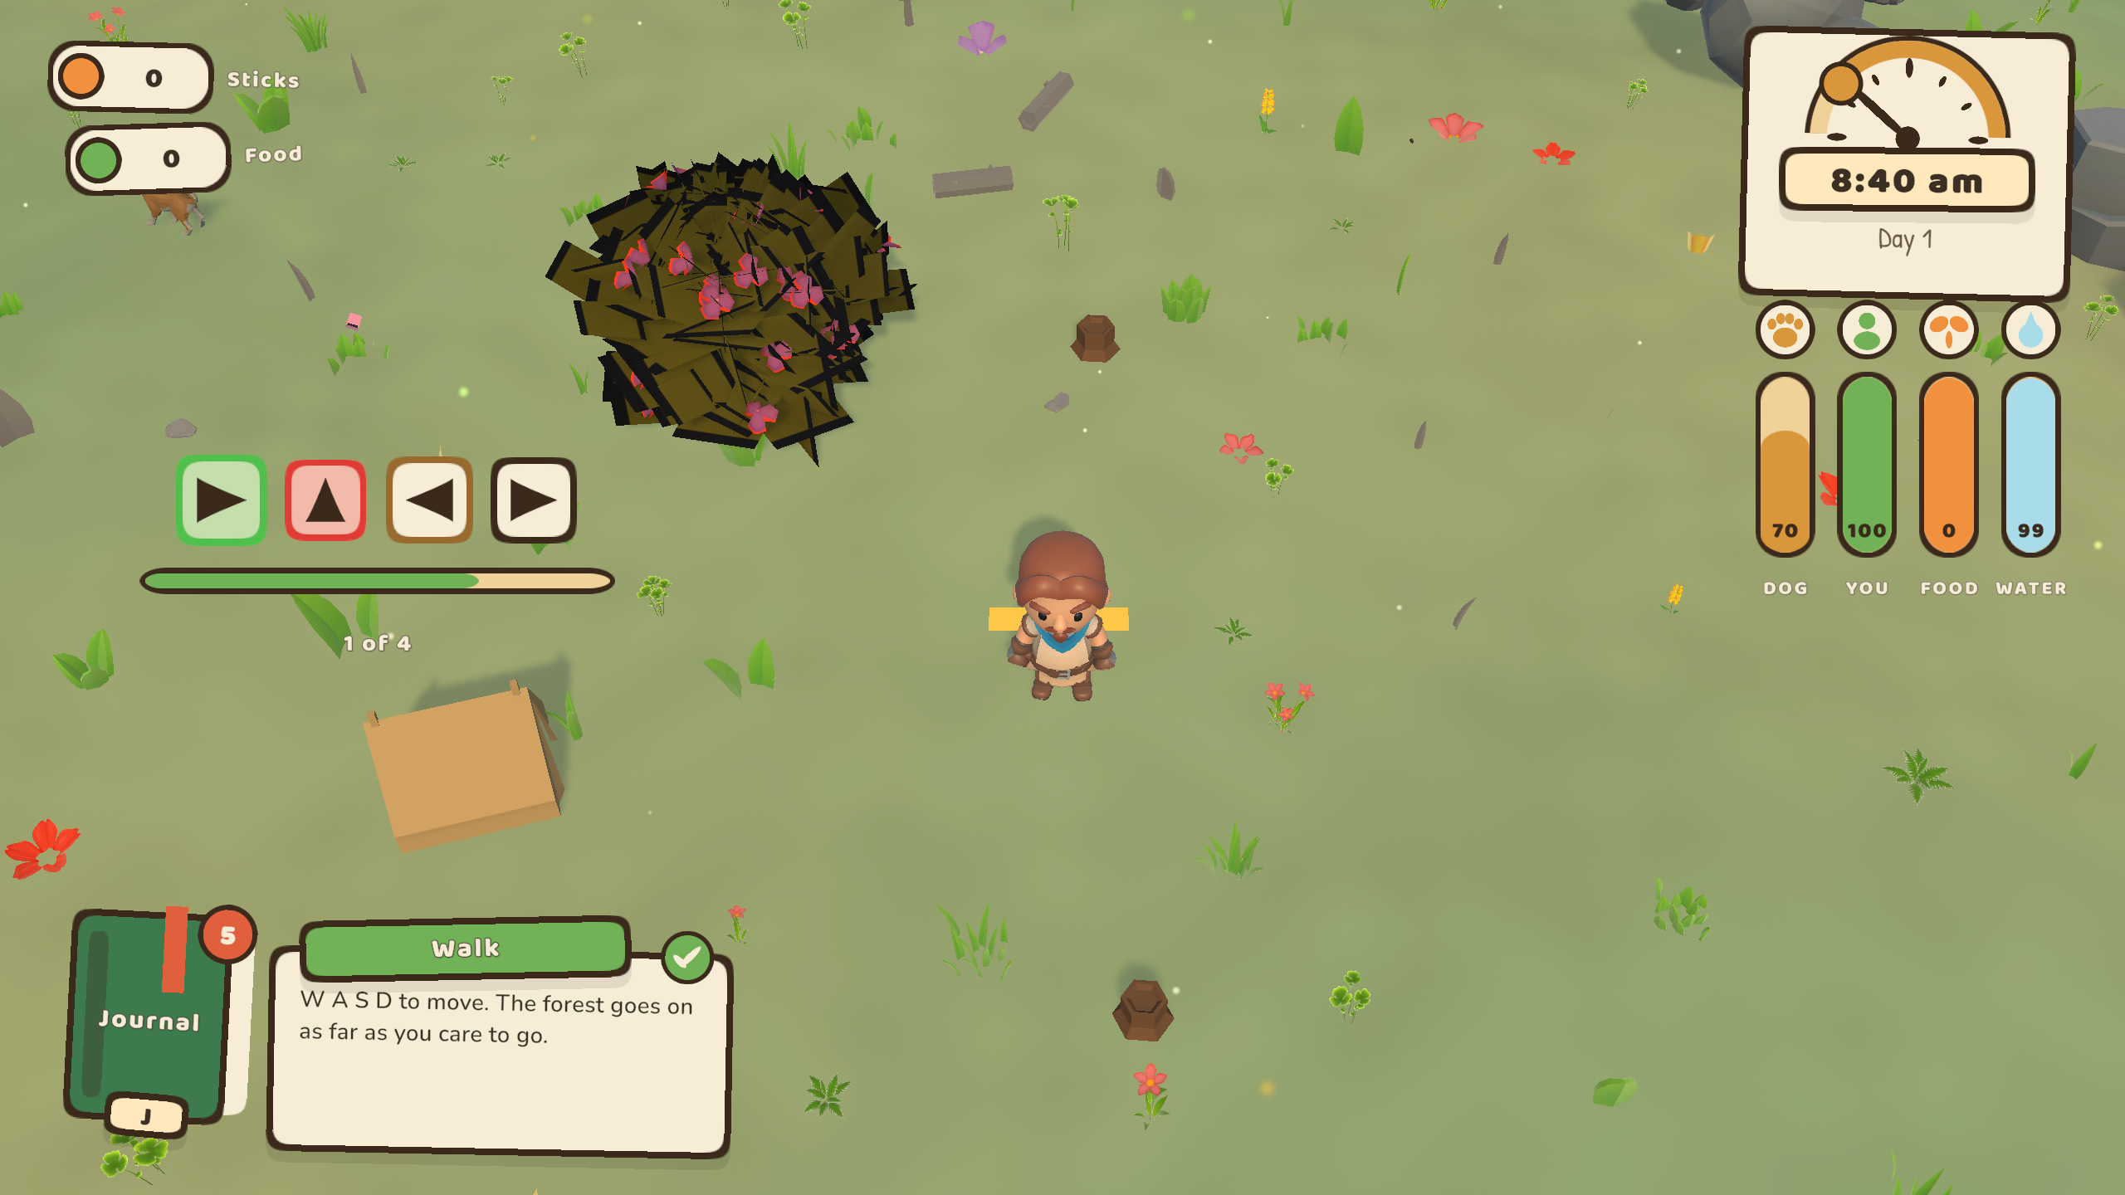
The photograph
A row of arrows in the air over the subject, under one shared timer.
Every press answers itself in colour - green border for a hit, red for a miss, thrown off as an expanding halo. A wrong press costs you that arrow, not the rest of the row.
The photograph is a real render of the real scene from a second camera, so a shot at dusk is dark because it was dusk.
arrows or WASD
Follow · 5/10

Slide 6
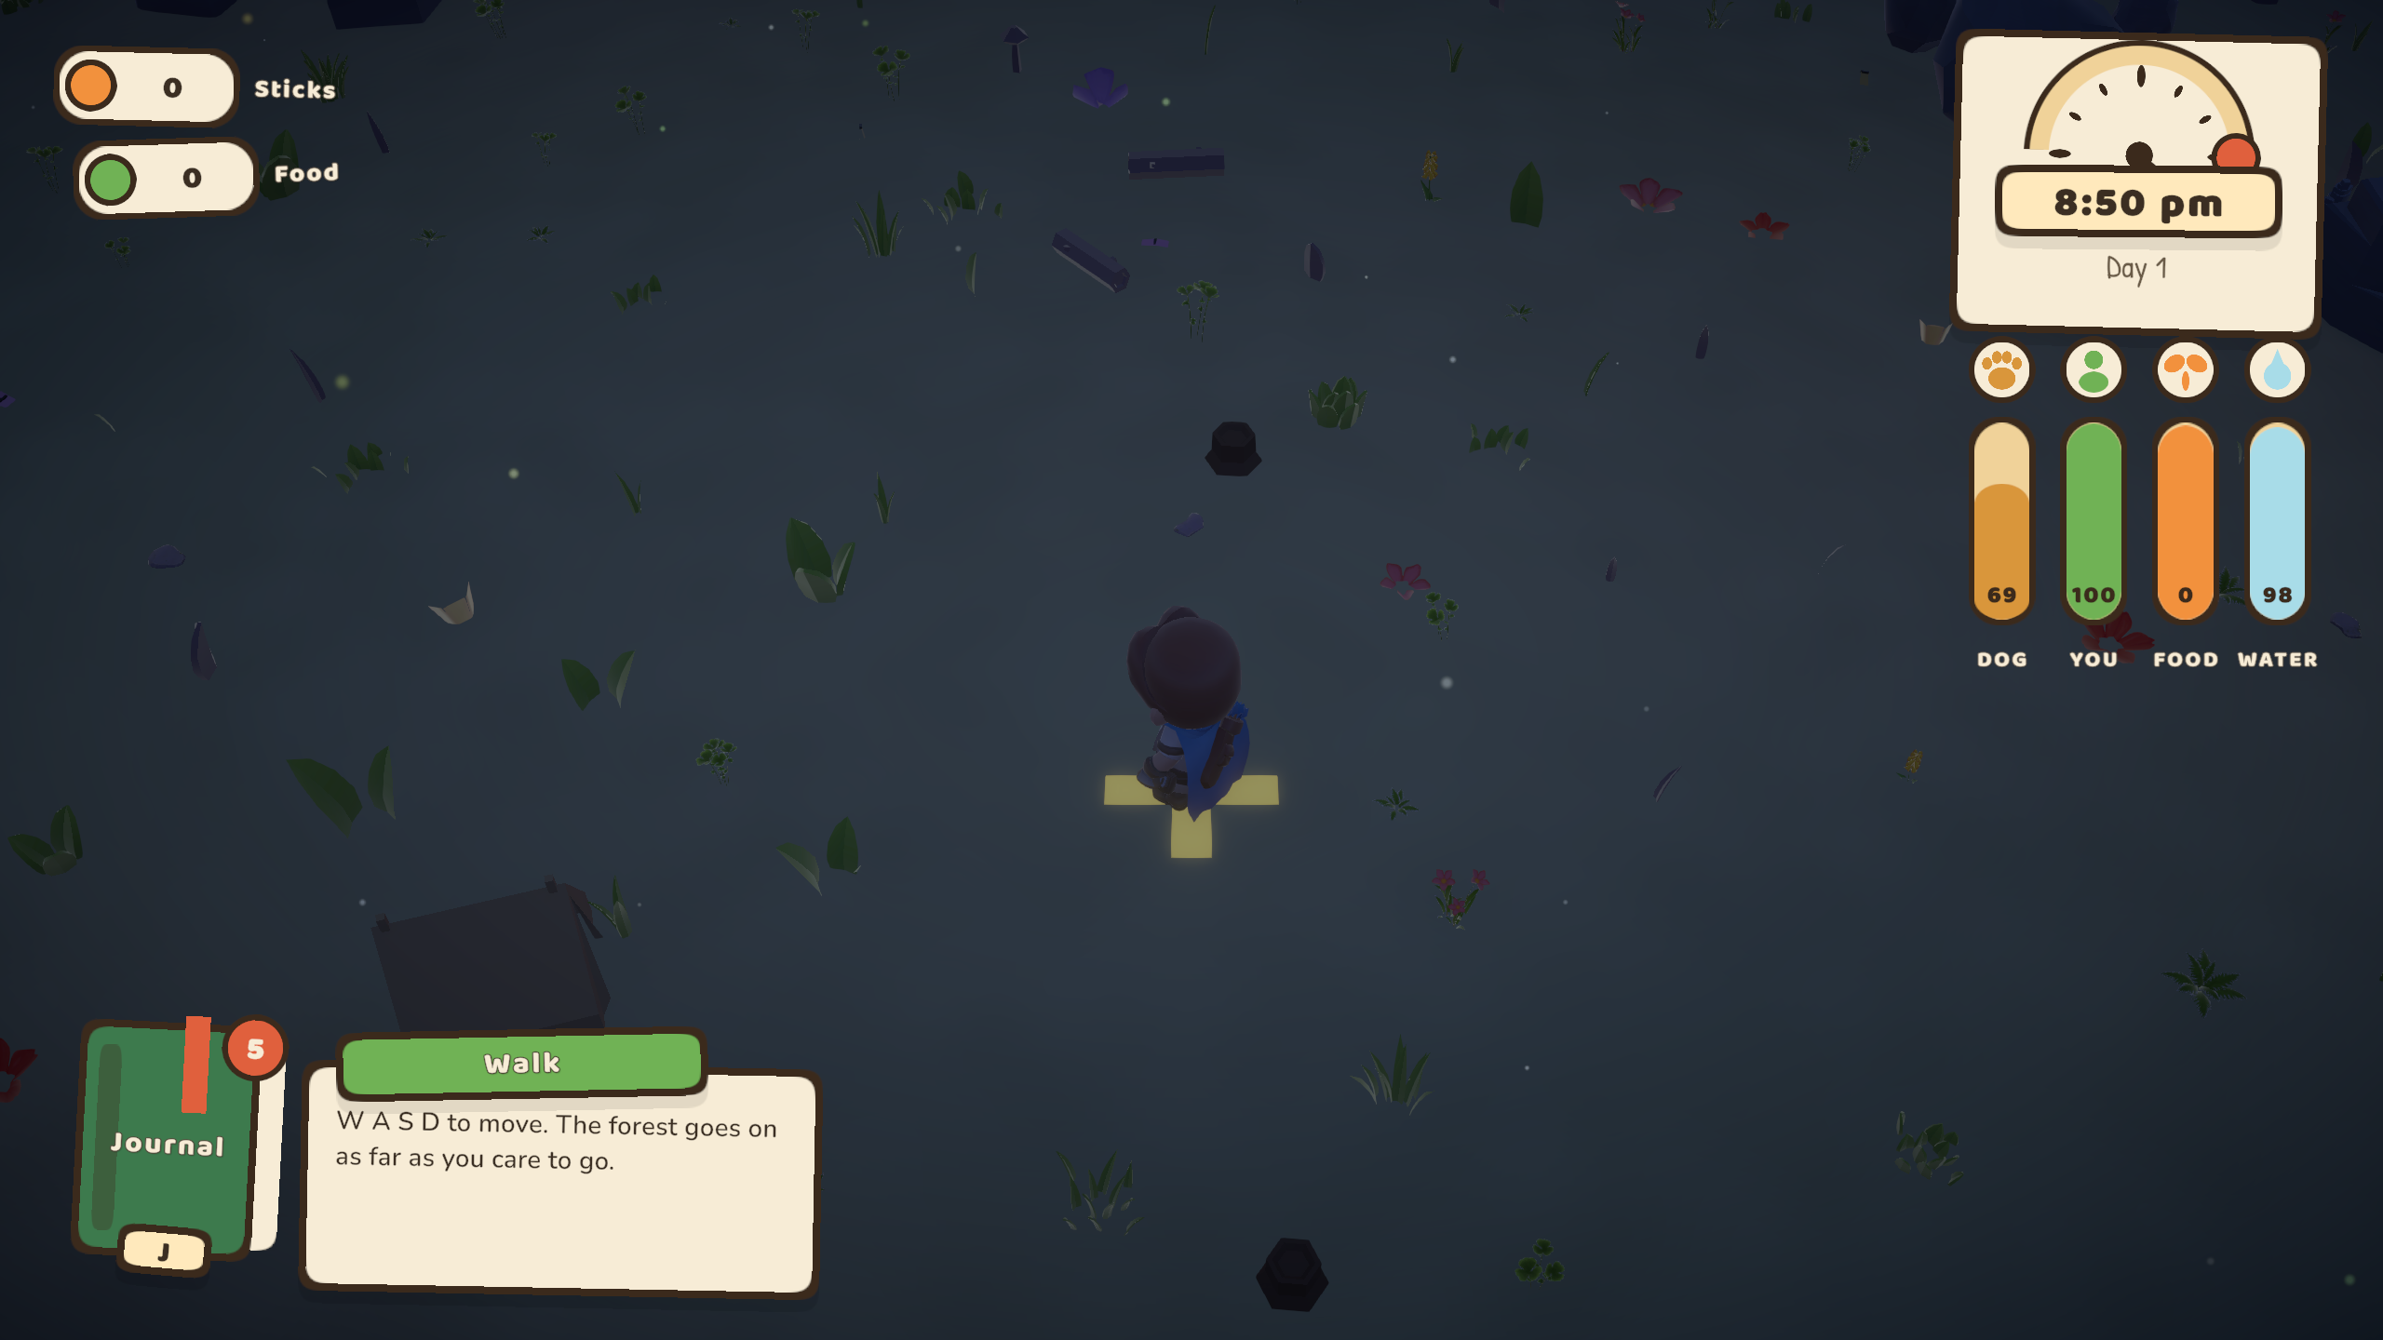
The day, and the night
A full twenty-four hours. Dusk takes seventy-five seconds of real time and the blue arrives through a twilight rather than at one.
When the light goes the survey stops - it is too dark to work, and the lit campfire is the only exception. That is what four sticks buys you.
Hunger, thirst and cold run underneath. Empty any of them and the screen irises out; you wake at camp a day older with nothing in your pack.
Follow · 6/10

Slide 7
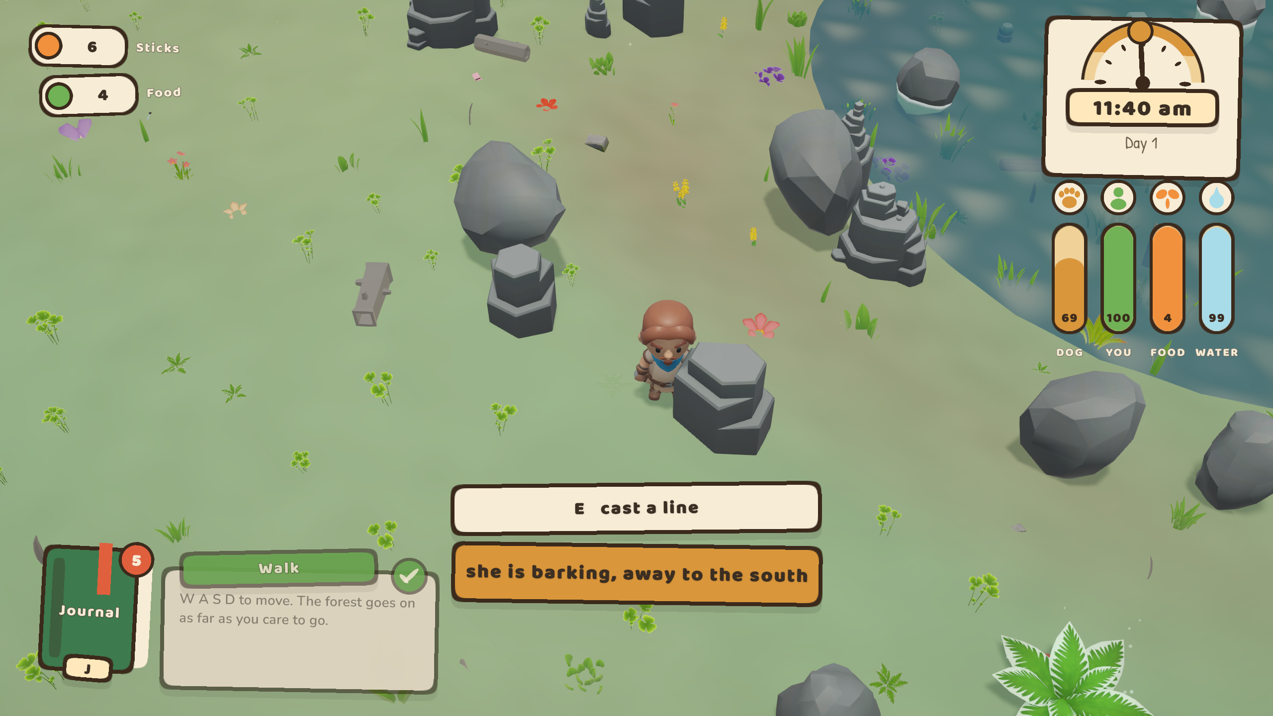
A forest with no edge
The forest is a set of pure functions of world position - height, moisture, canopy density, trail openness - plus landmarks hashed per 50 m grid cell.
Nothing is stored, so nothing can run out. Chunks are built and discarded around you as you walk, with analytic normals so there is no lighting seam at any chunk border.
Ponds sit in real hollows. Deer trails are the ridge of a noise field, which is a line that never ends - exactly what a path through an endless wood is.
walk a kilometre; it is still there
Follow · 7/10

Slide 8
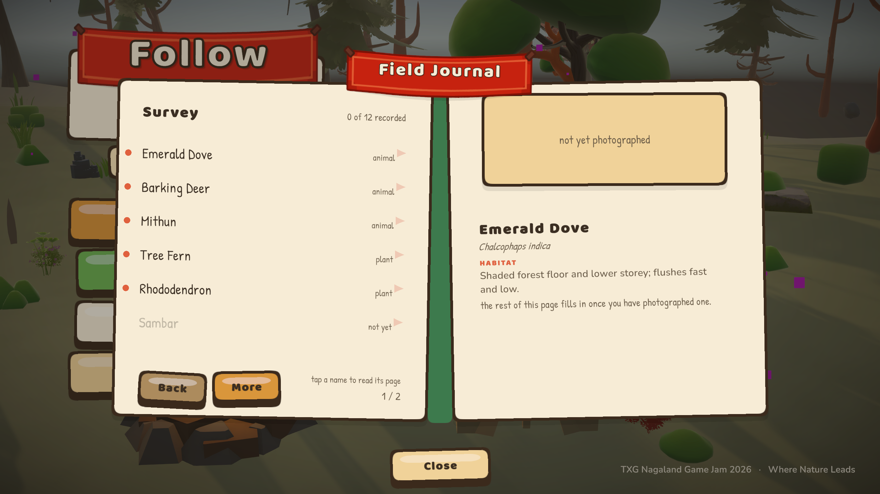
The field journal
Twelve species of Nagaland and the Eastern Himalaya - mithun, barking deer, dhole, emerald dove, blue vanda, rhododendron.
Every entry carries habitat, diet and a field note. The page fills in properly once you have photographed it, and your own shot goes at the top with the day you took it.
A guide you have not finished is the whole point.
Follow · 8/10

Slide 9
Built with
Unity 6.3 · URP
17,500 lines of C# across 81 files
Everything is a command
Scenes are baked by editor menu items, not hand-wired
Audio is synthesised
Wind, birds, crickets, music box, the whistle and the bark are generated into AudioClips at load
Custom shaders
Foliage wind with dither fade, stylised ground and water, soft particles
It cannot wedge
Movement holds, the modal counter and the clock all have watchdogs that hand control back
Windows and WebGL builds. No baked lighting, no large textures, well under the 250 MB cap.
Follow · 9/10

Slide 10
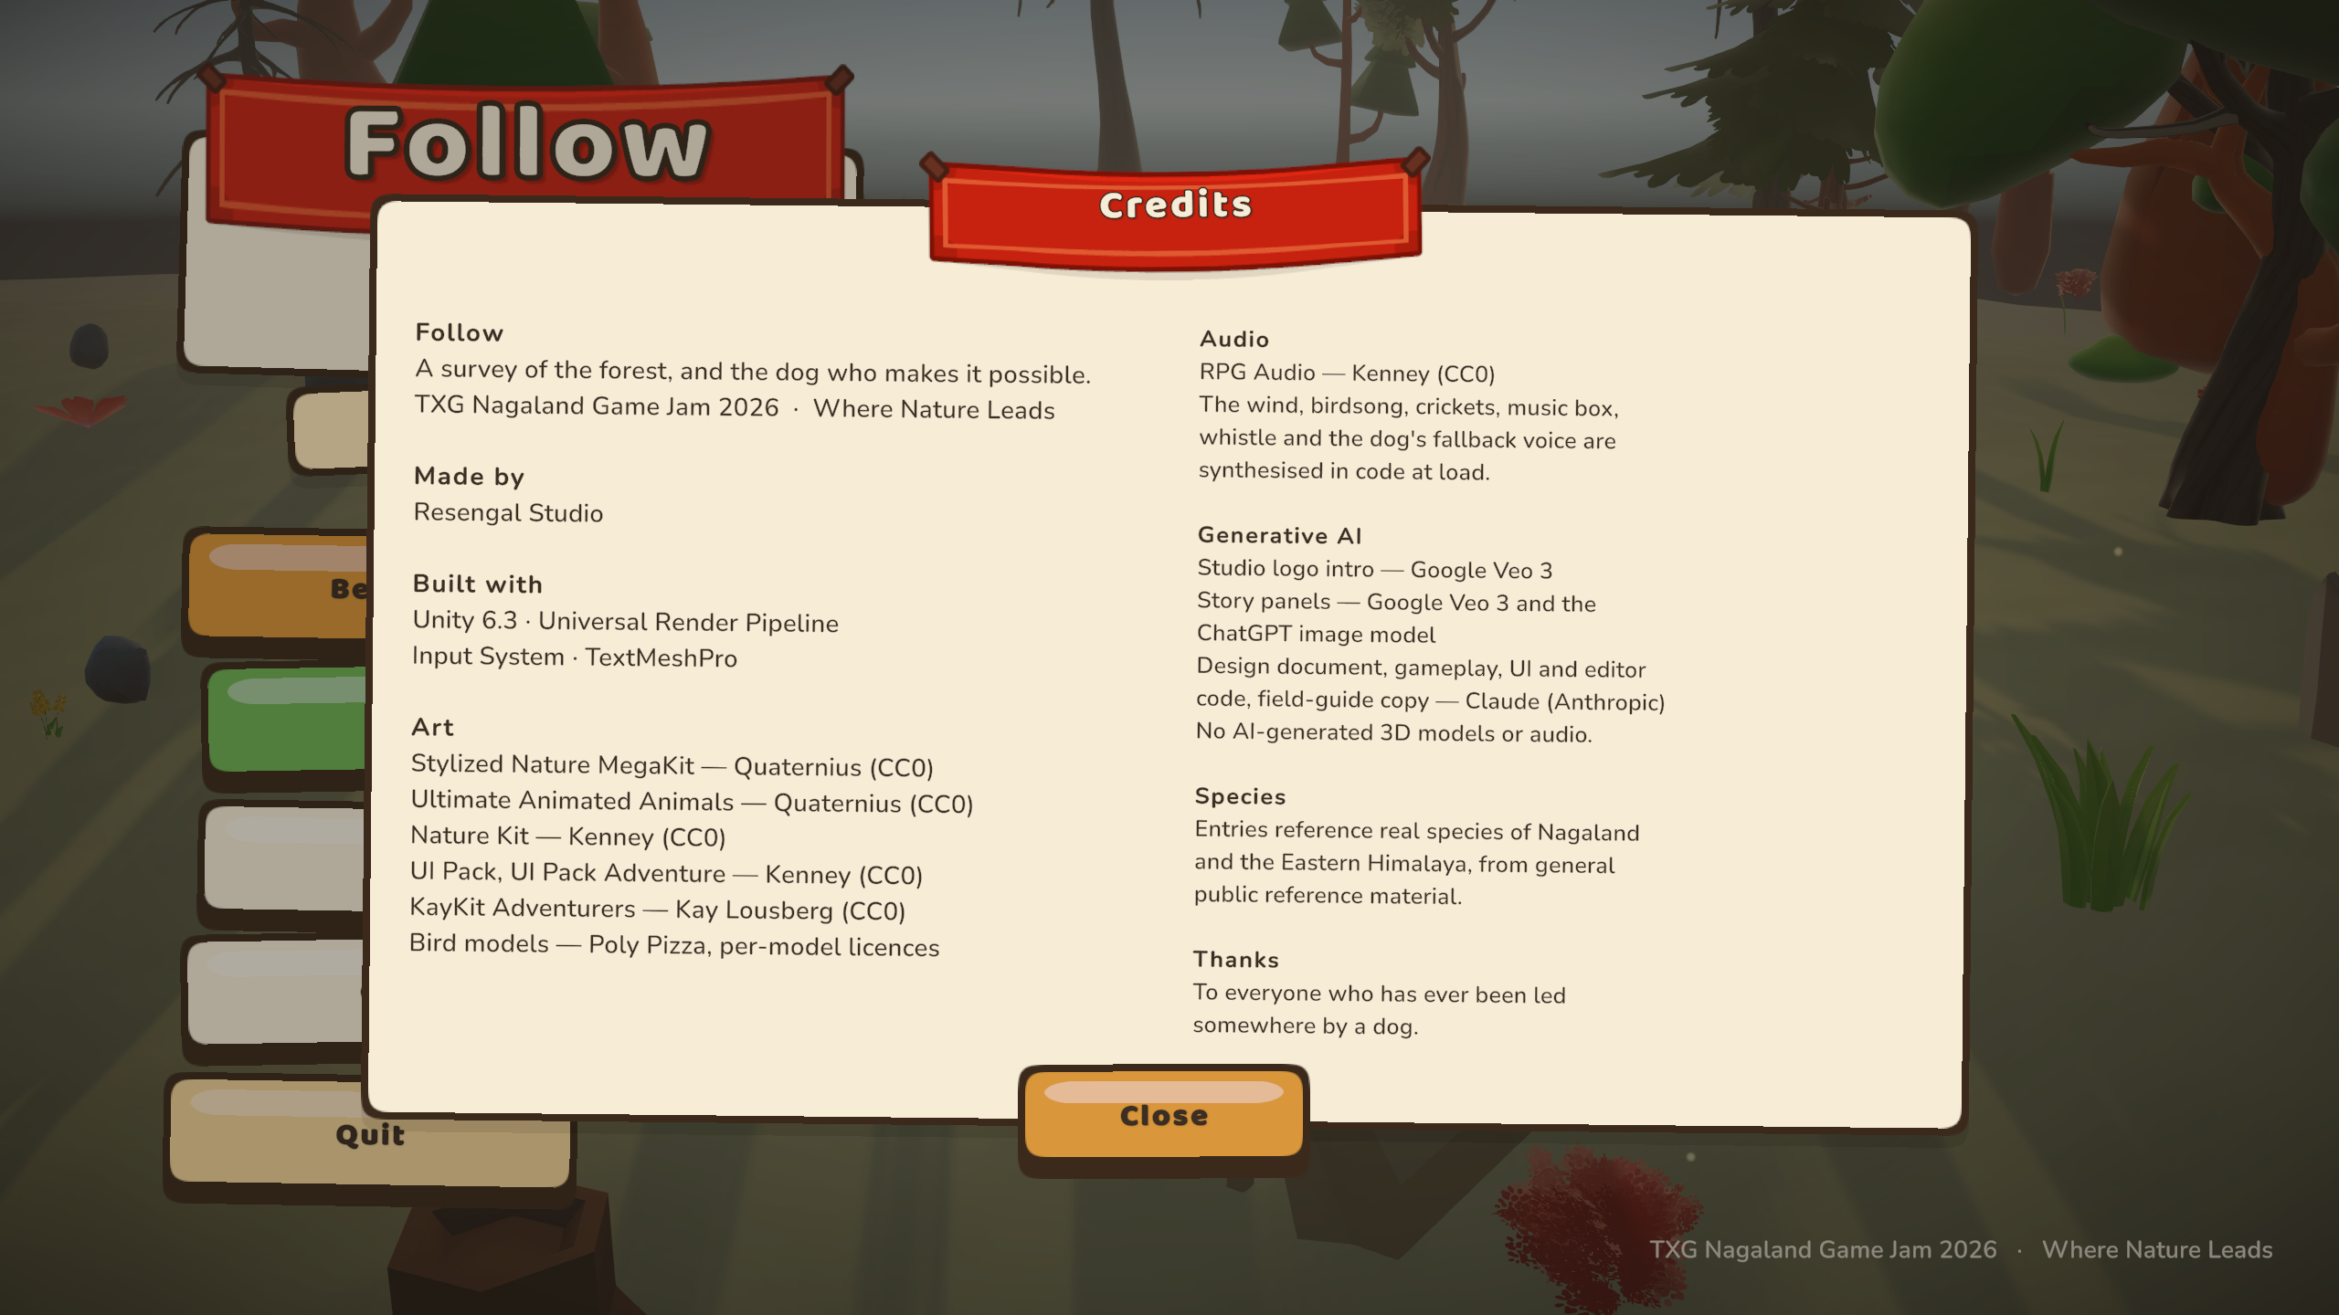
Thank you
Follow
TXG Nagaland Game Jam 2026
Where Nature Leads
Art from Quaternius, Kenney and Kay Lousberg, all CC0.
The studio logo and the story panels are AI generated;
full disclosure is in the game's Credits card.
To everyone who has ever been led somewhere by a dog.
Follow · 10/10

